Slide 1
What you should know about
Event Floral & Design Planning
- Educational Session -

Slide 2
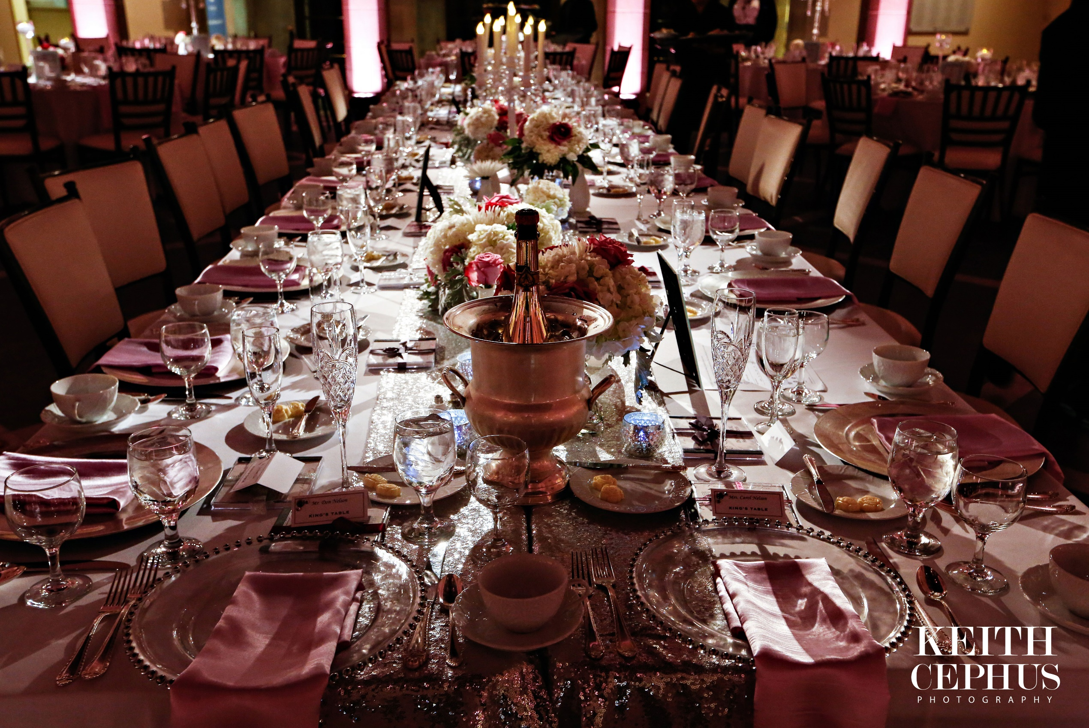
Welcome!
Vivid Expressions presents… Wedding & Event Floral Design Plan

Slide 3
Great Exceptions… (Note: Before stating, Did you download your free webinar worksheet?)
“What will you learn today?”
By the end of this session you will learn…
1. What is an “Event Floral Design & Decor Plan” and facts about an overall event budget
2. What unique factors are involved behind the designs with “event flowers & décor” that will impact your design plan
3. Why are wedding flowers costs so different? – Top 5 reasons
4. How to create you design plan for “the look you want” and how to prepare to collaborate with your floral professional
5. The “Most common mistake to avoid” when planning your flowers
Dragon Studio Photography
Notes:
Expectations & Concerns: (Exercise – ask attendees)
DID YOU DOWNLOAD THE FREE COMPANION WORKSHEET FOR THE WEBINAR?
What are you basing your floral budget on?
How much time have you given yourself for your research, development and planning process?
Do you have an actual “Floral budget plan” in place or do you need to review it?
Are you looking for the best floral design solutions for your wedding & budget?

Slide 4
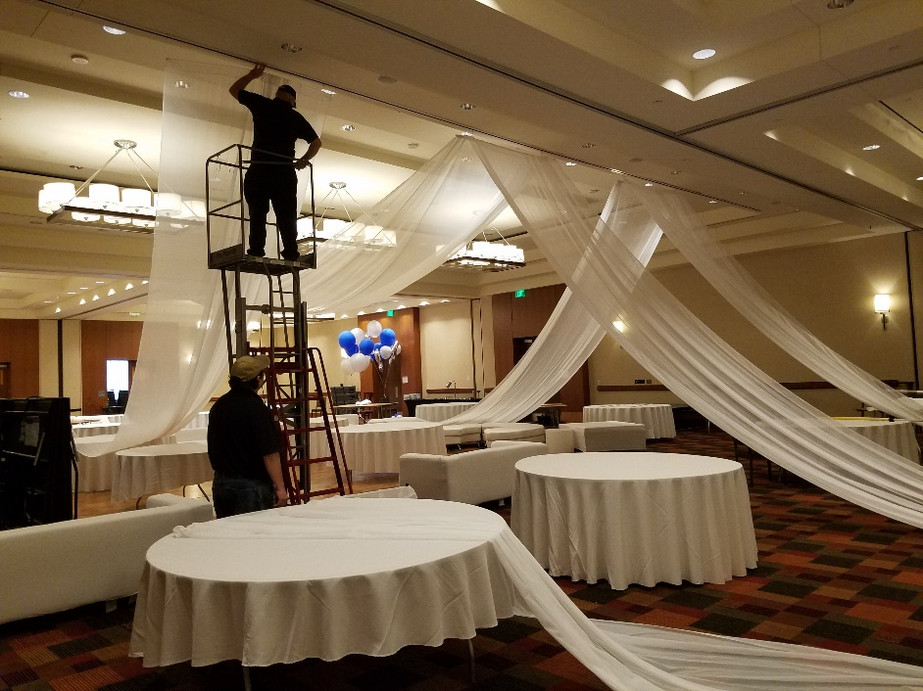
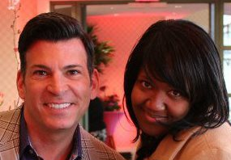
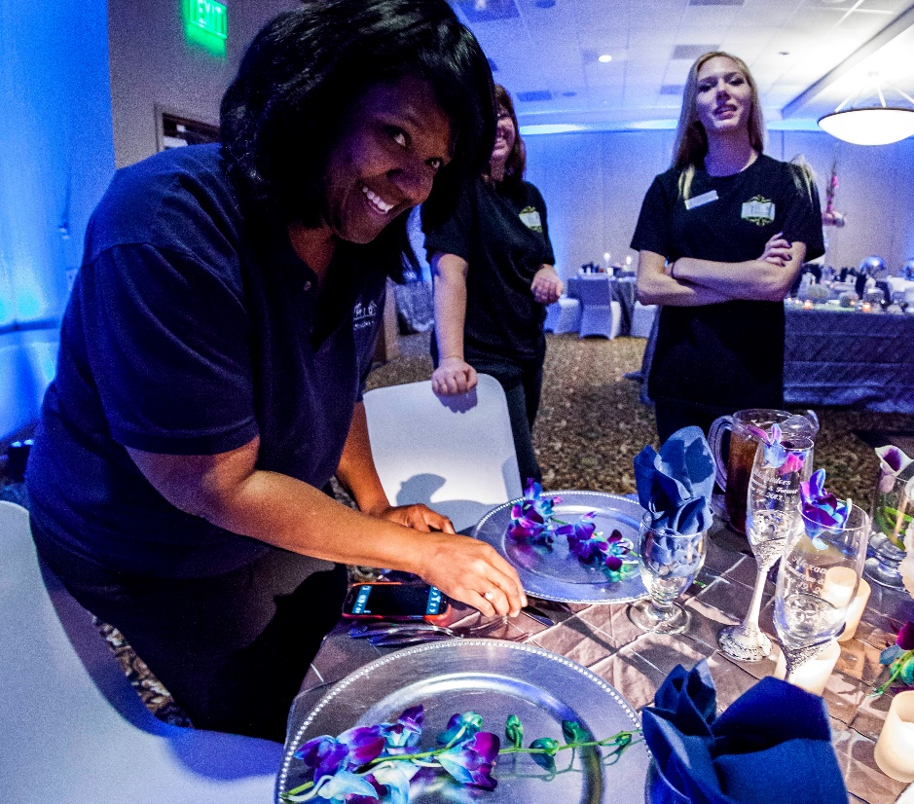
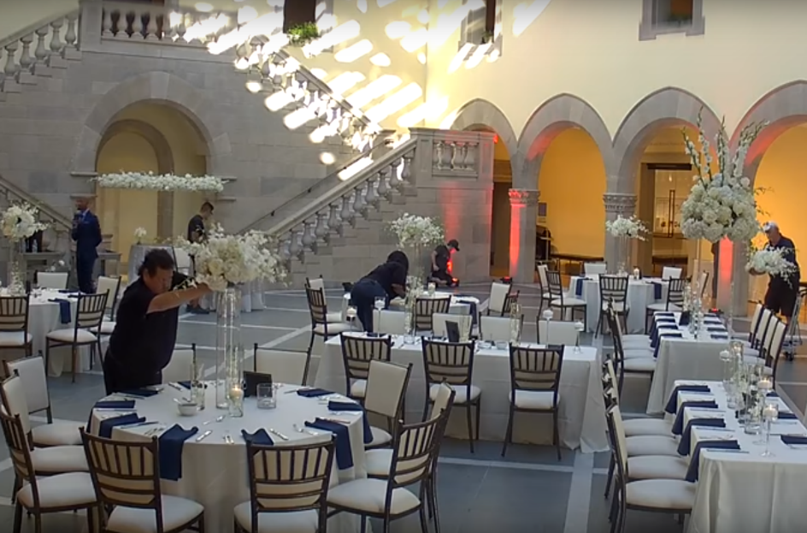
A little background about…
Established 2006
Veiw It Do It
Dragon Studio Photography
Fresh Look Photography
Notes:
“It all began in a State of Emergency” - Credentials & background:
(A little about the presenter – personal life, personal philosophy, pre-event industry, how I got into the industry, what qualifies me as an expert today, how to learn more about me on their own)

Slide 5
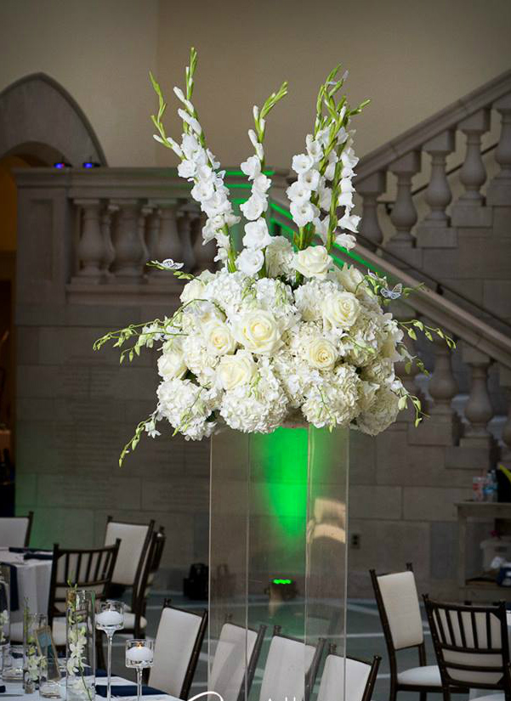
Have you found yourself looking at pictures, blogs, pins, or bridal show booths and asking a vendor, “How much does something like this cost?” … to figure the best way to the design your wedding? If you have, you’re NOT alone.
Flower Frustration__________________
What is an Event Floral & Décor Design Plan?
The truth is…
no two events or designs are exactly the same
Range $ - $$$$
The bottom line is without a true
event floral design plan some couples up …
“Piece mailing” instead of “Designing” their event which can lead to unnecessary frustration and a lot of “settling” to make their budget work.
About You Photography
Dragon Studio Photography
Notes:
“Flower frustration” –
Identify issues: (what is the problems, concerns, and needs)
What is a Floral Design Plan?
A design plan is concept development and a cohesive strategy to that maximized the budget to achieve the concept look
Cost vs budget
1 Prioritizing - Level of importance
2 Key style, theme and design preference
3 Production needs - *Identifying ALL components and production needs
One of many strategies that compreis the overall wedding plan
What will visually tell your story or set the scene for your experience?
Not greating a stregety before you start actually planning?
Design Budget vs Design Cost –
1. BUDGET is what you want to or a set limit to what you want to spend
2. COST is the actually and complete total of product including any services or fees associated with it’s final production from start to finish before, during and after your event.
HAVE YOU EVER ASKED?
3. PROBLEM!!! Often people set a budget before understand then products and services involved to create what they want.
4. ASKING “HOW MUCH DOES THIS COSTS” FROM SOMEONE ELSE WORK, FROM A PIC, BRIDAL DISPLAYS USUALLY HAVE A FLEXIBLE BUDGET BECAUSE AREN’T WORRIED ABOUT COSTS, MATERIALS, TIME, LABOR, ETC.
5. RESULT: Many times couples have a specific wedding budget in mind and while some stick to their budget, the reality is that things add up quickly and often exceed the original budget.

Slide 6
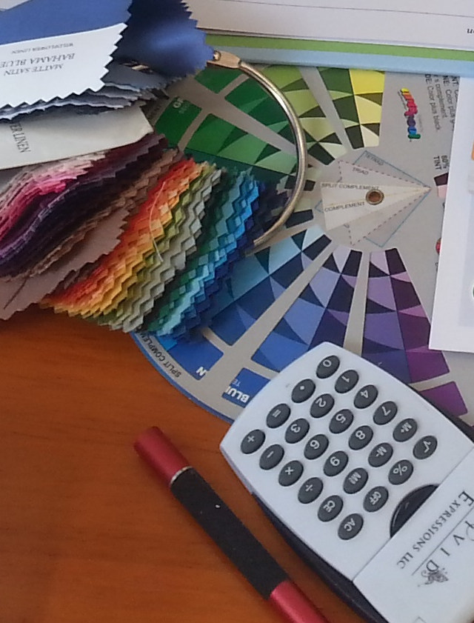
Festivity Facts
Newest industry number
*Base line expectations or “starting point” for weddings
Numbers may vary. For example: services, products, etc. differ in NY vs. SC
2017 NATIONAL AVERAGE WEDDING:
New industry reports - National average wedding budgets for 2017 at:
$28,000
AVERAGE MILLENNIAL COUPLE:
Millennial couples spending starts at slightly higher average - starting budget:
$30,000
COSTS VARY BY LOCATION: Coast VA:
Average Coast VA Couples can expect a basic spending range between:
$20,225 to $33,708
*NOTE: Higher-end wedding clients will spend more to receive a
“custom wedding experience”.
Notes:
2017 NATIONAL AVERAGE WEDDING:
New industry reports - National average wedding budgets for 2017 at: $28,000
Special note!
1. MILLENNIAL COUPLE: are spending slightly more average budget of $30,000
2. COSTS BY LOCATION - Coastal VA couples average which we consider the Hampton Roads area or from Williamsburg to Virginia Beach and even some parts of OBX spend between $20,225 -$33,708
1. Location – Region of the country, state, metro vs rural w/resources available, amenities retire, resort, demand,
2. Quality & Preferences – materials, details, embellishments, etc. taste and “good-eye”, No such thing as champagne taste on beer budget… some craft beers cost more than cheap champagne
Where does that number come from – what are they spending this on?
A single guest could add between $143 and $174 to the overall cost of your wedding.
< 50 guest = $9,000 - $15,000 (average $12,000)
50 – 100 guests = $14,000 - $23,000 (average $18,000)
100 – 200 guests = $22,000 - $36,000 (average $29,000)
200 – 300 guests = $28,000 - $47,000 (average $38,000)
>300 guests = $54,000 - $90,000 (average $73,000)
How many vendors will you hire? - Most couples will hire 13 to 18 vendors for their wedding. A big problem many couples run into is they may wait until ½ through the bookings to book their floral designer. (We’ll come back to that later)
Are you asking the right questions?
What types of questions are you asking your floral designer? Well in most cases they find themselves making the next biggest, and common, mistake. Picking items and they to piecemeal items together to fit into a budget by asking things like, “Well, how much is this... how much is that??” Which can give an inaccurate estimate and less bang for your buck. We’ll go into this more in just a minute.

Slide 7
Know your number
What impacts those numbers
Location
Hotel, conference center, banquet hall, barn, home, museum, garden, airplane hanger…
2. Preferences (including quality and scale)
Do flowers matter to you? Do chairs? What are your “must haves” and “deal breakers”?
3. Guest count: Based on average numbers, expect STARTING POINTS for “The basics”:
< 50 guest =
Starting point of $12,000
50 – 100 guests =
Starting point of $18,000
100 – 200 guests =
Starting point at $29,000
200 – 300 guests =
Starting point at $38,000
>300 guests=
Starting point at $73,000
Notes:
2017 NATIONAL AVERAGE WEDDING:
New industry reports - National average wedding budgets for 2017 at: $28,000
Special note!
1. MILLENNIAL COUPLE: are spending slightly more average budget of $30,000
2. COSTS BY LOCATION - Coastal VA couples average which we consider the Hampton Roads area or from Williamsburg to Virginia Beach and even some parts of OBX spend between $20,225 -$33,708
1. Location – We’ve already discussed “Region of the country, state, metro vs rural “but about the actual “LOCATION’S” Needs. The resources available, amenities, demand,
2. Quality & Preferences – materials, details, embellishments, etc. taste and “good-eye”, No such thing as champagne taste on beer budget… some craft beers cost more than cheap champagne
Chavrai chairs vs venue chairs (half moone)
Where does that number come from – what are they spending this on?
A single guest could add between $143 and $174 to the overall cost of your wedding.
< 50 guest = $9,000 - $15,000 (average $12,000)
50 – 100 guests = $14,000 - $23,000 (average $18,000)
100 – 200 guests = $22,000 - $36,000 (average $29,000)
200 – 300 guests = $28,000 - $47,000 (average $38,000)
>300 guests = $54,000 - $90,000 (average $73,000)
How many vendors will you hire? - Most couples will hire 13 to 18 vendors for their wedding. A big problem many couples run into is they may wait until ½ through the bookings to book their floral designer. (We’ll come back to that later)
Are you asking the right questions?
What types of questions are you asking your floral designer? Well in most cases they find themselves making the next biggest, and common, mistake. Picking items and they to piecemeal items together to fit into a budget by asking things like, “Well, how much is this... how much is that??” Which can give an inaccurate estimate and less bang for your buck. We’ll go into this more in just a minute.

Slide 8
Let’s imagine that you’ve walked into a local flower shop…
Perhaps we should be thinking…
“Chicken Marsala”
So, are we thinking about it all wrong?
Danielle Cote Photography
Notes:
When it comes to flowers – why are our cost expectations sooo off? You walk into a local Florist's or Event Designer's shop. You glace around and find yourself surrounded by selves and tables adorned with dozens of lovely vases, props and charming decorative accents. Along one of the walls or perhaps nestled in the back of the room you may see a large display case... a cooler filled with an assortment of beautifully designed floral arrangements; sweet little round arrangements, classic red roses in 10" vase, happy little daisies in a fun, bright container, and so on. And you wonder, "So why do 'wedding' (or special event) flowers cost so much?" Unfortunately the common thought among consumers is that a business hears the word "wedding" and just automatically charge more... well, not exactly.
While it's true that arrangements for weddings are more than "Everyday flowers" (more on that later) I'd like to share just a little insight as to what makes flowers for weddings and special events more expensive.
It's the same reason why you can go to one of your favorite restaurants, order a meal of Chicken Marsala with salad and drinks and pay anywhere from $20 to $30 per person (give or take) however, such a meal being catered for a reception could cost $50, $80 or more per person.
Let's consider that "dinner" we just talked about, better yet, think about that last time YOU cooked a big dinner for your family. How many people did you cook for? 3, 4 or maybe 5 people? Think about when you planned out the meal, looked up the recipes, and created ingredients and shopping lists. Think of the preparation time (peeling, chopping, etc), and actual cooking and baking time. Then, let's just assume you "go all out" and serve your family, you know, actually plate each meal and bring them to the table (no self-service). Now think about the clean-up after, not just the dinner dishes but all the prep dishes, pots, pans, and work areas including counter tops and the floors.
Ok, now, image cooking for 14 people instead of 4 or 5. How about 40, 140 or even 440 people...whew! What would you need to pull that off? How much extra help would you need to cook all those perfect meals as well as serve them impeccably and clean up afterwards? What type of equipment would you need? What if you were at a strange kitchen or a place that didn't have a kitchen? What would you have to prepare before heading to the location? How would you transport everything? Think of the cost of not just the actual food but the materials (including warming trays, plates, glasses, linens, etc.), special equipment, extra staff, transportation, and, of course, your own precious hard work and time... what would be the cost? The truth is things tend to become more complicated when done in large quantity and the more complicated things get, the more costly they become - especially if its to be done exceptionally well.

Slide 9
“Event Flowers” vs. “Everyday Flowers”…
Now, back to that Florist shop you walked into earlier…
Keep in mind those arrangements may have been:
Made and sold in the shop one at a time.
Made to order in the shop with what ever available staff and flowers are there that day.
Made days (and days) ago, kept in a cooler to keep fresh for walk-in customers and are often priced to move.
So, what makes “Event Flowers” difference?
Notes:
So, back to that Florist shop you walked into earlier. Those flowers you saw in the cooler? Those were more than likely "Everyday Flowers", the type of flowers you walk in off the street and pick-up on a whim. Most standard florist shops will always have some kind of Everyday, Seasonal or Occasion Flowers...
….you know, Mother's Day, Thanksgiving, etc on display. Seeing those flowers can be a little misleading. You only saw one maybe two of a single "Everyday" Floral Design sitting in those cases. Just keep in mind those arrangements may have been...
Made and sold in the shop one at a time
Made to order in the shop with available staff and blooms
Made to order in the shop with available staff and special ordered blooms
Made days (and days) ago and kept in a cooler for walk-in customers and are PRICED TO MOVE
These Everyday Flowers tend to be pretty standard designs and a little different than the specialty floral designs typically seen in weddings or special events which often uses different structural materials and event rental items.
When you are ordering custom-made Bridal Flowers, Ceremony Flowers (Alter Arrangements, Aisle or Pew Markers, etc), Cocktail/Reception Flowers, and more …
… you are actually ordering and paying for more than just a standard product …
… you are hiring ”a very specialized service” for your event.

Slide 10
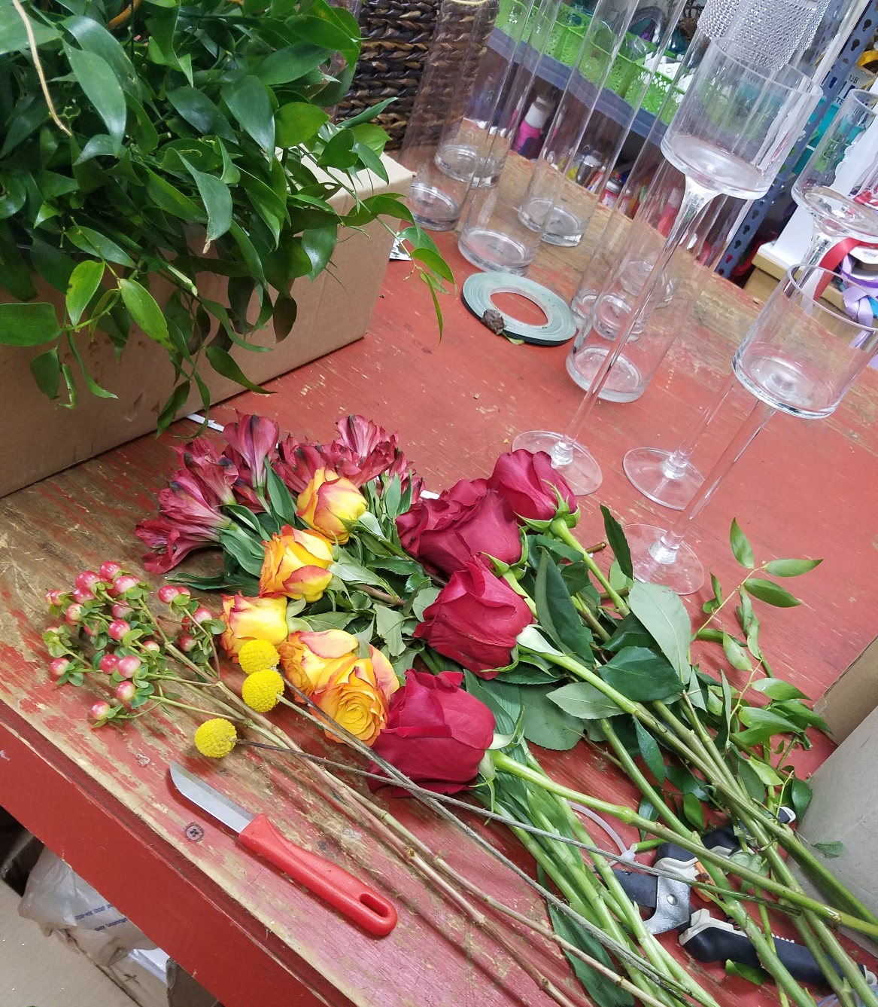
Well, what ARE you really paying with Wedding and Event Flowers?
Top 5 reasons:
1. Product and Materials
2. Mass Production, Time, and Labor:
3. Storage and Transportation:
4. Installation & De-Installation
… and cleaning
5. Hobby vs. Career
… professional training, experience, and skills
* BONUS REASON!
Although I’m sure you can guess what this one is. Taxes!!
No one can get away from payment taxes on products and even rentals.
Notes:
1. Product and Materials: Yes, this refers to the actual flowers AND includes:
Pro floral chemicals, tools, vase rentals, & production equipment (not including commercial Flower Coolers).
Many of these materials are used in the flower care and processing stages.
They are ALIVE. I think of flowers as a "living Art medium" that beauty can quickly fade if they become sick or mistreated. What happens if a supplier can't provide the right flowers, Customs damages them at airport, they pick-up a fungus or they are delayed in transit and die? Your Florist finds solutions & fixes it... plain and simple.
2. Mass Production, Time, and Labor:
Prepping flowers & making dozens of custom designs (bouquets, boutonnieres, corsages, arrangement) for a designated production schedule is very different from making a single design order.
Many Florists are professional trained or years of experience so they can handle event production
There may be situation where they’ve other projects, events, or store operations with daily walk-in customers and they may bring in the proper additional staffing - essential for producing designs for your event.
BOTTOM LINE: Depending on the style, size and materials it could take anywhere from 30 minutes to 2 hours to create BRIDAL bouquet. Ex: 60 bride, Toss 30, 30 x 5 BM, 15 x 10 bouts, 20 x 4 = 7.8 hours Typical Florist or Designer can commit 40, 80, 200 hours or more (IN TIME) on developing and creating your bouquet
3. Storage and Transportation:
After those flowers arrive, are processed or placed into lovely designs they’ll need to be properly stored (typically in cool, control temperature environments) and then transported.
Events involve timelines, scheduling, and delivery (possibly multiple locations); bouquets to the Bride's & BM’s location, boutonnieres to the Groom's & GM's location, flowers & decor at ceremony site, reception site, etc.
4. Installation:
Then, once delivered (depending on how elaborate) rentals & floral design may need to be assembled on-site or set-up on alters, pews, hallways, guest tables, cake tables, etc.
Later the florist & their staff will work with the venue(s) to schedule their breakdown and removal.
5. A professional - Hobby vs. Job:
I’m are extremely blessed to love what we do and do what we love - but we’re not here by accident.
I’ve had a long career in Art, Entertain, Tourism, Telecom & Marketing B4 I committed to this work.
Me and (others like me) have dedicated 100s of hrs of study, training, and experience to our craft, skills & knowledge.
I value each of our Clients. Their events are immensely important me. I understand what this is (a moment they may never relive again) means to them.
That scene of importance is why they hired a Pro. I AM A PRO… this is my job … I love It but it’s STIL my job.
This is how we have chosen to make a living, pay my mortgage, feed family, pay our bills, etc. We work hard AND expect to be paid for our time and hard work.
This is why some professional including a Design fee FOR design development, formula or receipt, calculations, consulting, budget management, sourcing, negotiating with suppliers to get the best product for your budget, etc
*** BONUS REASON!

Slide 11
Creating your Floral Plan
“What to include in your Floral Design Plan?”
So, what should you expect to pay for and include in your Floral Budget Plan?
PART I: CREATE A CUSHION
What you REALLY want –
Production Fees –
Changes -
Keith Cephus Photography
Notes:
You’d be surprises as to how many couples don’t have or create an actual Floral Plan. Think about it. You have a menu plan- example, what appetizer are services, plated or, what food will be service, budget and cost, etc. You have a plan for our music – what is type of prelude music will be played, will the groom have his own song or will all of the bridal party come out to the same thing, what is your 1st dance song, will you go straight into a Father-daughter dance and what songs, etc? You’re Floral Plan can be just as complex and, because it is static and consistent throughout the event, it can have a bigger impact than some people thing.
Cushion
What you want – Firstly, give yourself a cushion on the things you want the most. Consider this, on average, couples sped 50% to 100%+ more than they originally budget for when choosing good quality services and products:
well-experienced professionals
designer dress labels
popular event locations
unique or custom products and services.
(So, investigate ALL options as early as possible & choose products/services that best meet your needs.)
Production fees like designer, staffing, delivery, cleaning, etc.
Last minute Changes: Additional Guests, Bridal party members, etc
*Note: Most florist have a “Minimum commitment or investment” in their contract

Slide 12
Creating your Floral Plan
“What to including in your Floral Budget Plan?”
PART II: Determine your floral design look
These are “Starting point” for personal flowers, ceremony, centerpieces, table/room accents, and other decoration enhancements:
If the look of your wedding isn’t as important – can be sparse, minimal, or DIY look:
8% - 10% Simple personal flowers by professional and client doing DIY projects
If you like an average look with a simplistic but polished or cohesive look:
10% - 15% Starting point for personal flowers and simple centerpieces
If you’d like a more popular, themed, or chic look like a well-styled Pinterest look:
15% - 20% Starting point for more custom designs. Ex: Mix of tall and low centerpieces
If you’d like a high-end couture bridal magazine, movies, or even luxury wedding look:
20% - 25+% Starting point for more elaborate designs, details and design elements
Keith Cephus Photography
Notes:
Determine you designed look
If the look of your wedding is not as important to you with a sparse, basic, or DIY look - Flowers: 8-10 percent
NOTE: Simple personal flowers by professional and client doing DIY projects
If you like an average look with a simply but polished or cohesive look – Flowers: 10-15 percent
NOTE: Starting point for personal flowers and simple centerpieces
If you’d like some of the more popular, themed, or chic looks like a well-styled Pinterest look – flowers 15 – 20
NOTE: Starting point for more custom designs. Mix of tall and low centerpieces
If you’d like a high-end couture bridal magazine, movies or even luxury look – flowers 20 or more
NOTE: Starting point for more elaborate designs, details and design elements
Floral Designers will help you consider all of these elements, design solutions, and how to get the most impact for your budget

Slide 13
Creating your Floral Plan
“What to including in your Floral Budget Plan?”
PART III: Categories:
Personal Flowers -
Ceremony Florals & Décor -
Reception (not just centerpieces)-
Transitional & Room Elements –
Keith Cephus Photography
Notes:
NOTE – IF YOU HAVE THE WORKSHEET YOU CAN SEE THE QUANITITY, PRODUCT, AND FLORAL DESIGN MATERIALS DESCRITPION
-----------------
Floral and Décor Categories:
Personal Flowers -
Female (Bride, tossing bouquet, Maid/Matron of Honor, bridesmaids, Jr bridesmaids, flowers girls, mothers, grandmothers, hostess, sponsors, etc.)
Male (Groom, Best man, Groomsmen, Jr Groomsmen, Ring Bear, Coin bearer, bell ringer/sign barer, fathers, grandfathers, ushers, sponsors, etc.)
Ceremony Florals & Décor –
Alter (including ceremony items)
Aisle (including chair/aisle markers, path/custom carpet, etc.)
Entrance (optional)
Chairs (optional)
Reception (In addition to centerpieces):
Cake flowers & decor
Food service tables like buffet
Colored or specialty linens including napkins, overlay or textured linens
Table Accents like chargers, specialty glass or silver wear
Signage like table numbers or signs, place cards/seating charts, etc.)
Transitional & Room Elements:
Pre-function/cocktail hour
Floral walls or sculpture
Display flowers
Ceiling drape or décor elements like chandeliers
Restroom flowers
Production Fees – Most often forgotten component: Time, labor, delivery, and other elements specific to your event needs

Slide 14
Clearing up confusion… who does what and who do you need?
Event (or Wedding)
Planner
Event Designer
Glenn Fajota Photography
*“Day of” Wedding Coordinator
Venue Wedding Coordinator
Floral Designer (Florist)
Notes:
It sounds like these titles are interchangeable
…and there are some professionals who were more than one hat
but here are
5 different, often confused, event professional titles and their responsibility.

Slide 15
So ask yourself, “What do you need?”_________________
Here are some common traits we see over and over again with Designer service clients. “So, do you…
need more "free time" because of your job, school, social activities, and family obligations?
want to be active in planning but need to stay on track, have professional support or not miss anything?
want to stay in control of decisions but need help refining a million ideas and getting great resources?
have a short amount of time to plan your event and need help executing the event designs?
plan on hosting it at a unique venue or have complex designs in mind and want support with special needs?
want a team of professionals to handle the “Day of” work including loading, set-up, returning to breakdown, clean, etc. so you and your guests can relax and enjoy yourselves?
Remember, every service provider is different.
For example: after our 90 minute design session to really identify all of your preferences and pieces of your needs we then…
Presented to you
Behind the scenes
Beautiful experience
Notes:
Designer experience
Features
Advance
Benefit

Slide 16
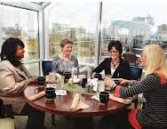
Wasting time
MOST COMMON MISTAKE TO AVOID …
Why is this a problem?
Losing the one you love.
Saying, “If I’d only known…”
Less time can actually cost more
The answer
VOW Bride Magazine
Start a conversation - Met with them as early as you can. You don’t need ALL of the concepts and details:
Date (even if it’s just tentative)
General size (Number of guests)
General Bridal party size (Example: Number of bridesmaids, flower girls, mothers, grandmothers, etc.)
Location (ceremony and reception – even if it’s just tentative)
What “type” of help you’re looking for design consulting, rentals, set-up, or you’re still unsure
Notes:
Last but not least.
Why is this a problem?
Losing the one you love –
Can tell you how many Brides, grooms and even planners experience this.
Missing out on highly sought after florists who can book early - for example: We can typically book up to 8 to 12+ before an event during popular wedding months or cool dates like 7/7/17 or 8/18/2018) Can we still book 4, 3 or 2 months out? Yes, it’s certainly possible but there may be other challenges.
If I’d only known –
Discovering the actual total costs are more than you’ve budgeted for AND it’s too late to work to give yourself time or a payment plan to get what you really want. The result is settling and piece mailing your designs
Can actually cost more -
Now, of course we’ve helped clients who were have a last minute wedding, putting together a “surprise wedding”, are in the military, and you know… challenge accepted!! I’ve had a bride contact me for a small wedding of just bridal party flowers only with just 6 weeks notice.
I love making miracles happened – I’ve been called Fairy Godmother more than once BUT having time is the biggest advance a couple could have
Gives them more options - example, I work with growers & distributors all over the country & even world.
I’ll occasionally have a client who has a particular look or floral design suite would normally be no problem BUT rush sourcing and shipping product in at the last minute it could cost more. Same with bringing in staff unexpectedly to accelerate the production schedule.
The answer – Start the conversation.
Most floral designer will offer you a free initial consultation. This helps us as much as it helps you.
We can determine what your specific needs are and calculate what you’ll need specifically for your products, flower counts, and services. I know for us at Vivid Expressions, we simply do not take every client that comes to us because I know we are not a great fit for everyone and not everyone is a great fit for us. The bottom line is if we are not the best fit for each other at least after the consultation I’ll know enough about your specific needs to possibly refer you or point you in the right direction.

Slide 17
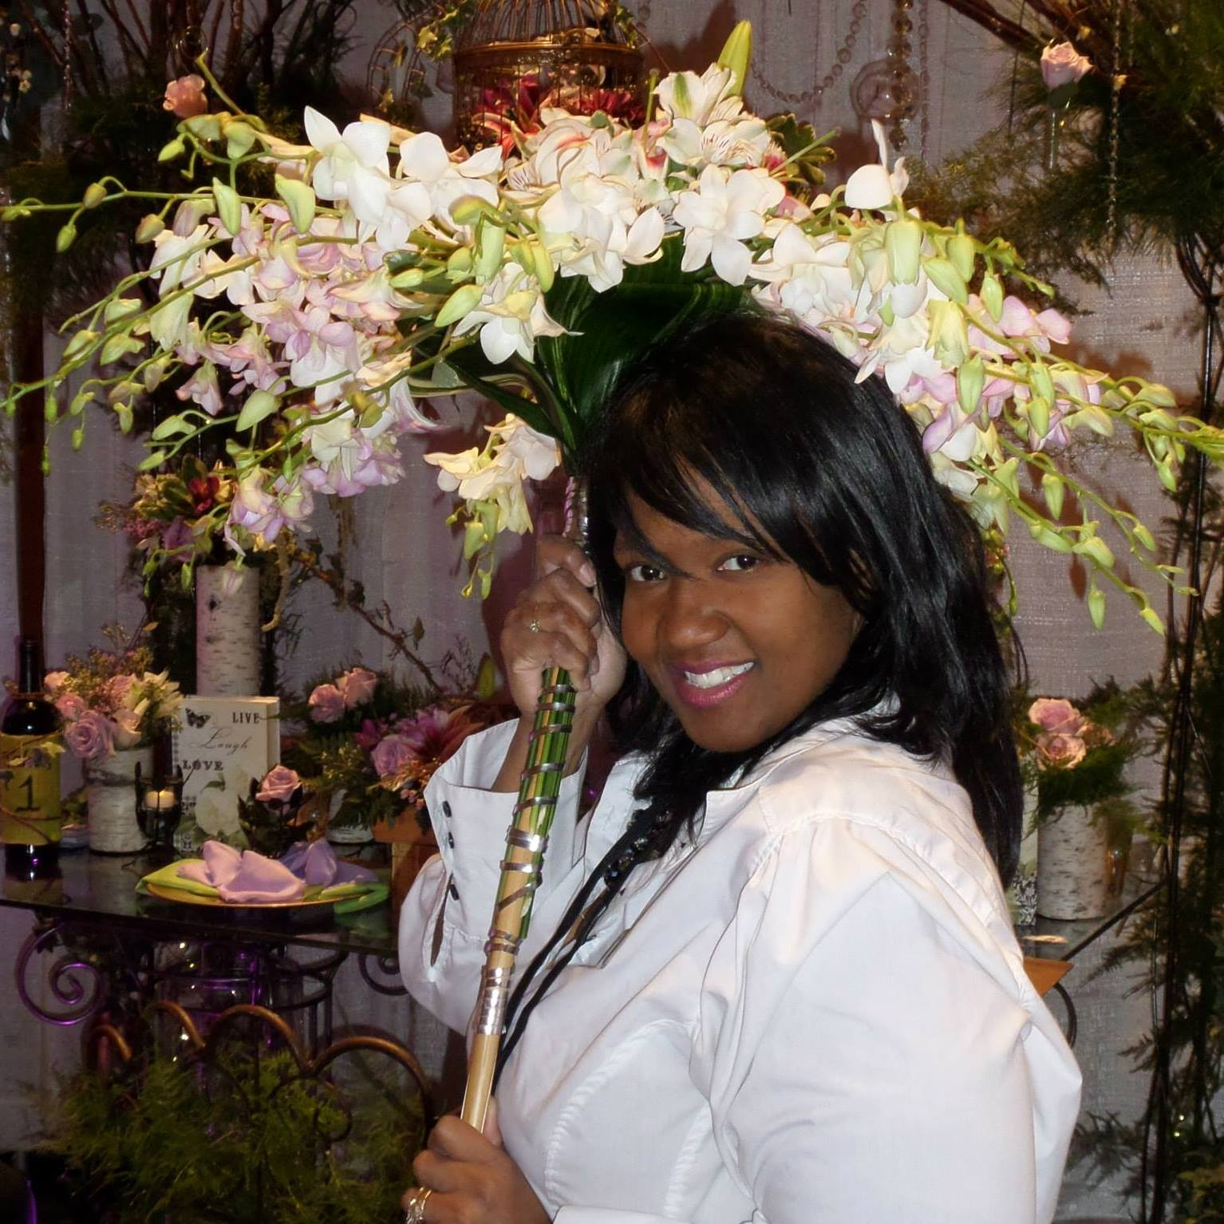
Questions or… need more help?
Me: Janel Bailey Keen,
Creative Director & Lead Designer
Direct email: JanelKeen@vividexpressions.com
Complete a Questionnaire or Contact us to schedule your personal consultation at: www.VividExpressions.com

Slide 18
Thank you for joining me!
Stage Right Lighting

